Slide 1

OiAIP & iPack ML Design Doc
David Crook | Sr. SDE
DaCrook@Microsoft.com

Slide 2
Responsibilities
OIAIP
iPack
OOB Models
Define Set of OOB Model Classes
Provision Required Resources & Provide Endpoints for
Upload data, get labelling tool url, train, get train runs & metrics, export & register model for target
Custom Models
Define specification for package format & config
Provision Resources & Provide Endpoints for
Upload data, get labelling tool url, train, get train runs & metrics, export & register model for target
Define ML Models Required
Define Workloads requiring models & expected model drop location.
Creating Interface Leveraging Resources & Endpoints provisioned by Platform
Implemented as part of admin app
Custom Models
Define Pipeline Package Location
Define class of pipeline (AML Pipes for example)
Labelling Tool as Docker Container

Slide 3
OOB Model Flow
ML APIS in OIAIP
Capture New Data for iPack
Get # Currently Staged Captured data for iPack
Train specific model in specific iPack with specific parameters
Get available parameters for model definition
get specific model’s train runs & metrics
export & register specific train run.
Get telemetry access information
Get captured data staging access information
Clear captured data staging store
OiAIp
Upload iPack

Slide 4
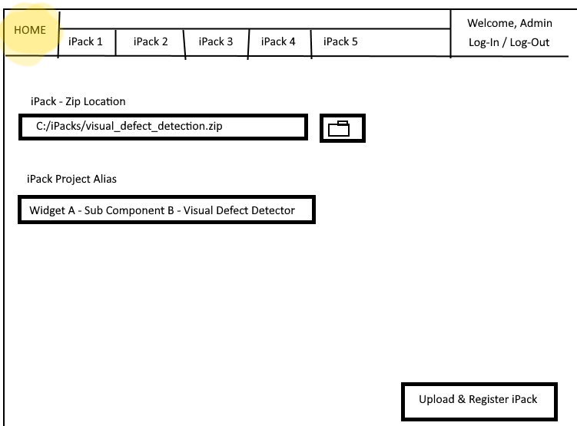
OIAIP Admin - iPack Registration Mock Up

Slide 5
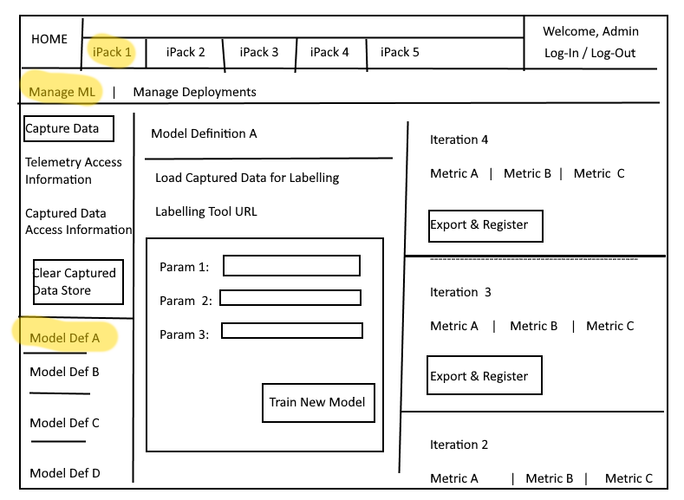
Initial iPack Mock Up

Slide 6
API Definitions & Data
Capture New Data for iPack:
POST: https://hosturl/api/v1/data/capture/ - body = application/json
Properties
“PackId” - String
“ProjectAlias” - String
“StartCollectTime” – DateTime as UTC
“CollectDuration” - TimeDelta
OPTIONAL:
“Tags” – List<String>
“TimeOut” – TimeDelta (Default 12 hours)
What it does:
Put Message on Azure Queue
If IOT: Send Cloud to Device Message
If Cloud:
Open Question: Who dequeues the message? The Device Capture Module(s) or the cloud service? How is this done?

Slide 7
API Definitions & Data
Get # Currently Staged Captured data for iPack:
POST: https://hosturl/api/v1/data/captureddata/staged/ - body = application/json
Properties
“PackId” - String
“ProjectAlias” - String
What it does:
Retrieves the quantity of data currently staged (collected, but not transferred) in the iPack’s staging blob waiting to be transferred to the labelling tool’s storage location.
This is counted as a discrete number of blobs in the blob storage.

Slide 8
API Definitions & Data
Get Model Parameters & Default Values
POST: https://hosturl/api/v1/ml/models/params/ - body = application/json
Properties
“PackId” - String
“ProjectAlias” – String
“ModelDefinitionName” – String
What it does:
Returns a JSON with following values
“PackId”,”ProjectAlias”,”ModelDefinitionName”,”Params”
“Params” : Dictionary – key value pair where the value is the default for each param.

Slide 9
API Definitions & Data
Train Specific Model for iPack
POST: https://hosturl/api/v1/ml/models/train/ - body = application/json
Properties
“PackId” - String
“ProjectAlias” – String
“ModelDefinitionName” – String
OPTIONAL:
“params” : Dictionary<<param_name>,<param_value>>
Defaults to defined defaults
What it does:
Retrieves the quantity of data currently staged (collected, but not transferred) in the iPack’s staging blob waiting to be transferred to the labelling tool’s storage location.
This is counted as a discrete number of blobs in the blob storage.

Slide 10
API Definitions & Data
Train Specific Model for iPack
POST: https://hosturl/api/v1/ml/models/metrics/ - body = application/json
Properties
“PackId” - String
“ProjectAlias” – String
“ModelDefinitionName” – String
OPTIONAL:
“limit” – Int (limits number returned to this value; grabbing just the latest) If not provided, returns ALL
What it does:
For each run of the specified model, retrieves:
“PackId”, “ProjectAlias”, “ModelDefinitionName”, “RunIteration#”, “RunStartTimeUTC”, “RunEndTimeUTC”, “RunStatus”, “Metrics”
Metrics: Dictionary Key Value, key is the parameter name and value is the value of that key/metric.

